Slide 1
Wikipedia Search Automation
As prepared by Naman Sharma

Slide 2

Introduction
This project uses the Wikipedia API for Python. It also uses Flask, which is a web application framework in Python.
This project has 2 parts:-
File Handling
Web application

Slide 3

Methodology
In File handling part, we provide a program that asks the user on the console to enter a keyword to be searched and fetches the data related to that keyword as it would be seen on the website of www.wikipedia.org .The data is returned from the module is then copied on to a text file and stored in the user’s system in a folder with the same name as the keyword searched.
In web application part, we have created a web page that lets the user input a keyword in a text box and then retrieves the data related to that keyword(if any) and then prints it on to the following web page in sections.

Slide 4
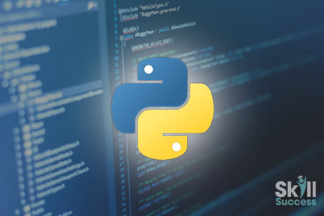


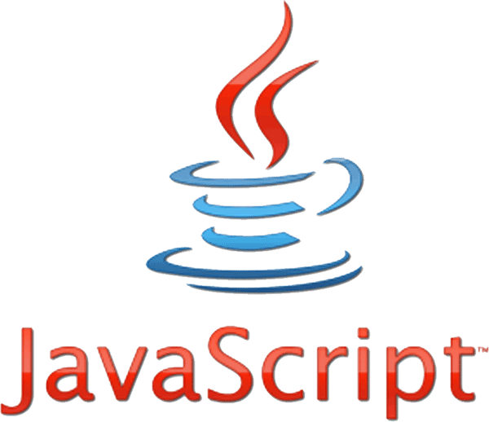
Languages that were used in making this project were Python, HTML, CSS and JavaScript
Python modules that were used in this project are: Wikipedia, OS, Sys and Flask.
Wikipedia module contains the builtin functions for the Wikipedia API.
OS module in Python provides functions for interacting with the operating system. This played an important role in the file handling part.
The sys module provides functions and variables used to manipulate different parts of the Python runtime environment.
Flask is a lightweight WSGI web application framework. It is designed to make getting started quick and easy, with the ability to scale up to complex applications.

Slide 5
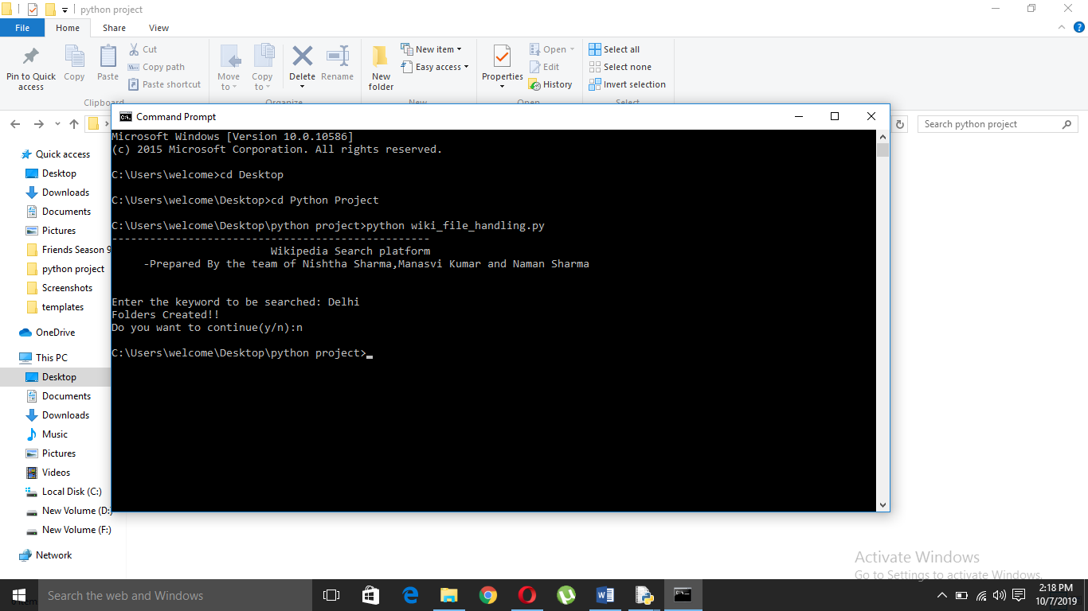
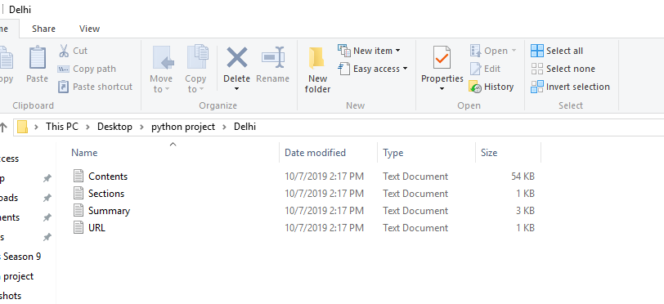
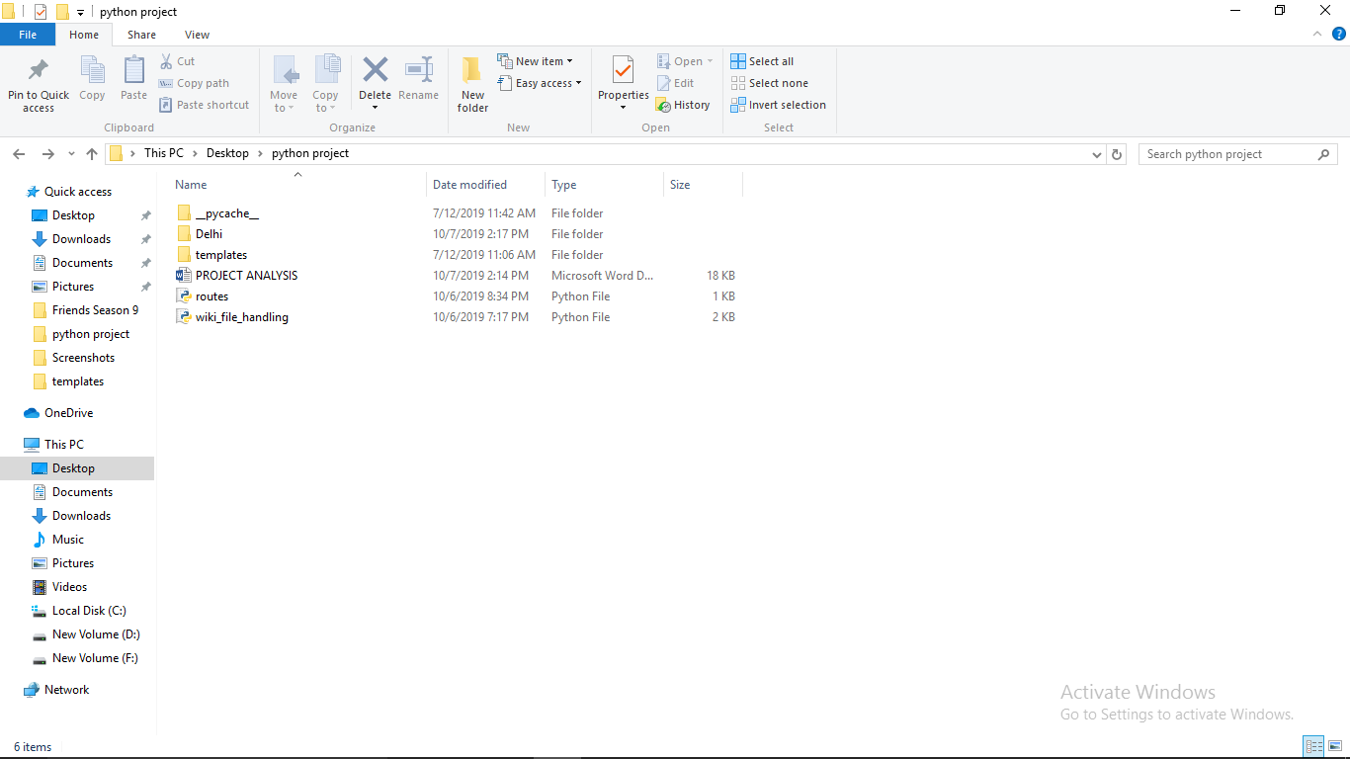
Screenshots
(Click the arrow when in Slide Show mode)
Notes:
In Slide Show mode, click the arrow to enter the PowerPoint Getting Started Center.

Slide 6
